Slide 1
As I see the tremendous impact of small things,
I realize there are no small things.

Slide 2

The Wise Choice Mentoring Model:
Helping Students Get Unstuck
Linda Williams
Learning Strategies
Student Academic Success Services
Queen’s University
sass.queensu.ca

Slide 3

“If you come to the fork in the road, take it.”
- Yogi Berra
Healthy lifestyle choices
+
Efficient study habits
+
Positive habits of mind

Slide 4
Wise Choice Model
Dream Big
Design Action Plan
Assess Situation
Develop Creator Perspective

Slide 5
Step 1: Dream Big and Set Intentions
Mentee’s Dreams | Mentor’s Questions | Sample Answers
Desired inner experiences (about being, feeling, thinking) | “What do you want your life at school to be like?” | Fit in, sing in choir, enjoy campus activities, feel independent, feel calm, friendship
Desired observable outcomes (about doing, getting, having) | “What do you want to achieve at school?” | Earn specific grade or GPA, find a summer job, keep scholarship, learn to program in C++

Slide 6
My Goals as Instructor
Throughout the day, I will feel calm, organized, and engaged.
Throughout the day, I will model good teaching/mentoring skills. I will be open to questions and comments from you and will respond constructively.
By the end of the day, I will have taught 4 sessions.
By the end of the day, I will feel satisfied with what I’ve taught you by modelling, instructing, and through exercises.

Slide 7
Feedback from Peer Mentor Homework
Help Mentees make distinction between:
  what they want to achieve (i.e. observable outcomes)
  vs.
  how they want to feel or live (i.e. inner experiences)
Break large, vague goals into smaller, more specific steps:
Poorly structured goal: I want to be healthier
Better structured goal: I want to be healthier, so I’ll
    eat 6-8 servings of vegetables and fruits every day,
    sleep 7.5-9 hours a night, and
    go to the gym every other day

Slide 8
Group Exercise
Using the DAPPS format, write your personal goals for today’s training:
    1 or 2 desired inner experiences, or emotions
    1 or 2 desired achievements, or new skills
Remember, well-structured goals are:
Dated, Achievable, Personal, Positive, Specific

Slide 9
Step 2: Assess the Student’s Situation
Conversation
    Your Mentee is the best source of information
    Ask directly about issues, surrounding situation, their explanation of events
    Focus on (negative) issues + better times
2. Assessment Forms
    Student Wellness Assessment or the Five Domains of Health
    Use to systematically guide conversation or assign as Mentee homework

Slide 10
Observation & Discussion of Role-play
Watch for these things:
Building rapport, encouragement, and hope
Encouraging perspective and identifying strengths
Language related to goal setting, obstacles
Introduction to using Student Wellness Assessment
Refer to Student Wellness Assessment handout

Slide 11
Tips on using Student Wellness Assessment
First, reinforce the specific strong items (4, 5’s)
Second, identify topics of weak areas (1, 2’s)
Ask about their response to the exercise: Self-critical? Discouraged when they completed it? Fairly accurate?
Finish with hope: “We can work on this together” or “You’ve got good skills in X. I admire your determination to tackle Y.”

Slide 12
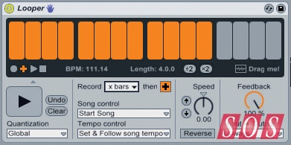
Step 3: Helping Students Develop a
Creator Perspective

Slide 13


Inner Dialogue
Victim Language
Creator Language
Inner
Critic
Inner Defender
Inner
Coach
Inner Creator

Slide 14

Victim Language
 | Blames | Inner Dialogue
Inner Critic | The individual | I’m not good enough. I’ll never get it right. I should have started earlier. They’ll think I’m dumb.
Inner Defender | Others | My group was disorganized. The prof. gave bad instructions. The TA hates me.

Slide 15
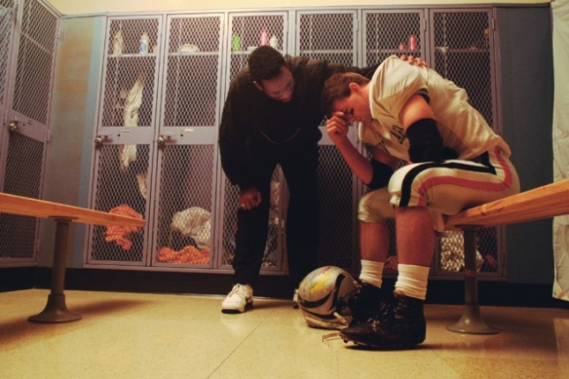
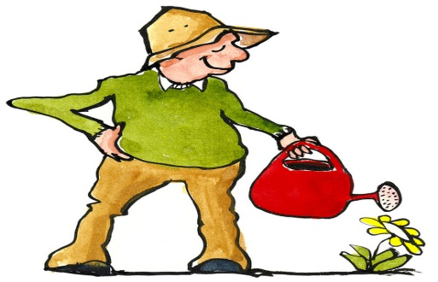
Creator Language
 | Encourages | Inner dialogue
Inner Coach | Your “self”, emotions, ability | You can do it. A messy draft is OK. You’re smart enough to learn this. Keep trying.
Inner Creator | Perspective, creative problem-solving, ownership | My assignment is late. I need to email my prof and make a plan. I’ll do it now.

Slide 16

Exercise: Write Creator Language
“The problem is I can’t get up in the morning for 8:30 classes. Therefore I will…”
THINK individually. Write 3 Creator statements (4 mins)
PAIR with a new neighbor
SHARE your statements (3 mins)
Did you feel empowered by the Creator Language?

Slide 17

Challenges?
What was difficult in this exercise?
How would you introduce the concept of
Inner Dialogue to a Mentee?

Slide 18
Step 4: Designing an Action Plan
✓ Desires,
Goals
✓ Troubleshooting
✓ Assess Situation
✓Commitment
✓ Options and Outcomes

Slide 19
Sample Words: Action Plan
Gain Commitment:
“We’ve covered a lot of ground today. We talked about X, Y, Z. What specific [strategy, action, task…] makes the most sense for you to focus on this week? What will you commit to doing?”
Troubleshoot:
“This sounds like a good choice. Can you imagine anything getting in the way of you doing it? How can you proactively troubleshoot those obstacles?”

Slide 20
Sample Action Plan
Goal | Obstacle | Strategy & date | Observation, Revisions
Eat better | Limited vegan options in cafeteria | Contact campus Dining about options (Jan. 14) | Met Jan. 15 — order placed for cafeteria
Get to all classes | Sleepy | Bed by 11:30, up by 7:45 (Jan. 14) | Hard! Monday a.m. worst. Try 11pm relax then bed at 12. (Jan. 20)
Stay caught up in Biology | Hard to find time | Make study schedule, allow 8 hours homework (Jan. 20) | Structure helpful, need 10 hrs/week per course (Jan. 27)

Slide 21
Facilitator Tips: Mentees Making Changes
Change takes time and is a risky process.
Work on one issue at a time, perhaps over several weeks.
The Wise Choice model is collaborative. Focus on mentee goals and move at their pace.
Change happens through your caring approach as a Peer Mentor, joint practical strategies, and your Mentee’s persistence.

Slide 22
Exercise on Wise Choice Model
Develop your language. What would you say to:
Group 1: Describe the roles of Mentees and Mentors?
Group 2: Discuss their completed Student Wellness Assessment?
Group 3: Explain and ask about goals?
Group 4: Explain and ask about inner dialogue?
Group 5: Assess the student’s situation?
Group 6: End the first mentoring session?

Slide 23
Applying the Wise Choice Model
Mentoring meetings use the Wise Choice problem-solving model to tweak previous strategies, and to address new issues:
  Opening: social conversation, homework
  Goals: topic or issue for today’s meeting
  Assess: practical obstacles, inner dialogue
  Strategies: Peer Mentor models or explains strategies directly related to current issue
  Action Plan: homework for Mentee, Peer Mentor

Slide 24

Creating a Success Plan
A Success Plan is a record of techniques, strategies, and tips that have proven useful in managing the Mentee’s personal or academic issues.
Why make it?
  Fosters self-reflection
  Tracks positive summary of growth, change
  Reinforces independence in future problem-solving
  A “Tool Kit” for next term

Slide 25
Sample Success Plan
Specific issue or challenge | Specific strategies that helped me | Things to remember in applying the strategy
Time management: “Not knowing where to start with all of the work I have to do.” | Term Calendar: Review my syllabi and record important dates (assignment due dates, tests, quizzes, exams, etc.). Priority Matrix | Put Term Calendar somewhere I can see it, as a reminder of these upcoming dates. Use all quadrants

Slide 26
Did you meet your goals today?
Check ✓ if you met your own goals:
1 or 2 desired inner or emotional experiences
1 or 2 desired achievements, or new thoughts or skills

Slide 27
Questions?

Slide 28

One Thing I Learned

