Slide 1
Counselling in Residence
Residence Outreach Counsellors
Freeman Woolnough, MEd, CCC
Nadia Sawaya Fehr, MA
Queen’s University – Residence Life

Slide 2
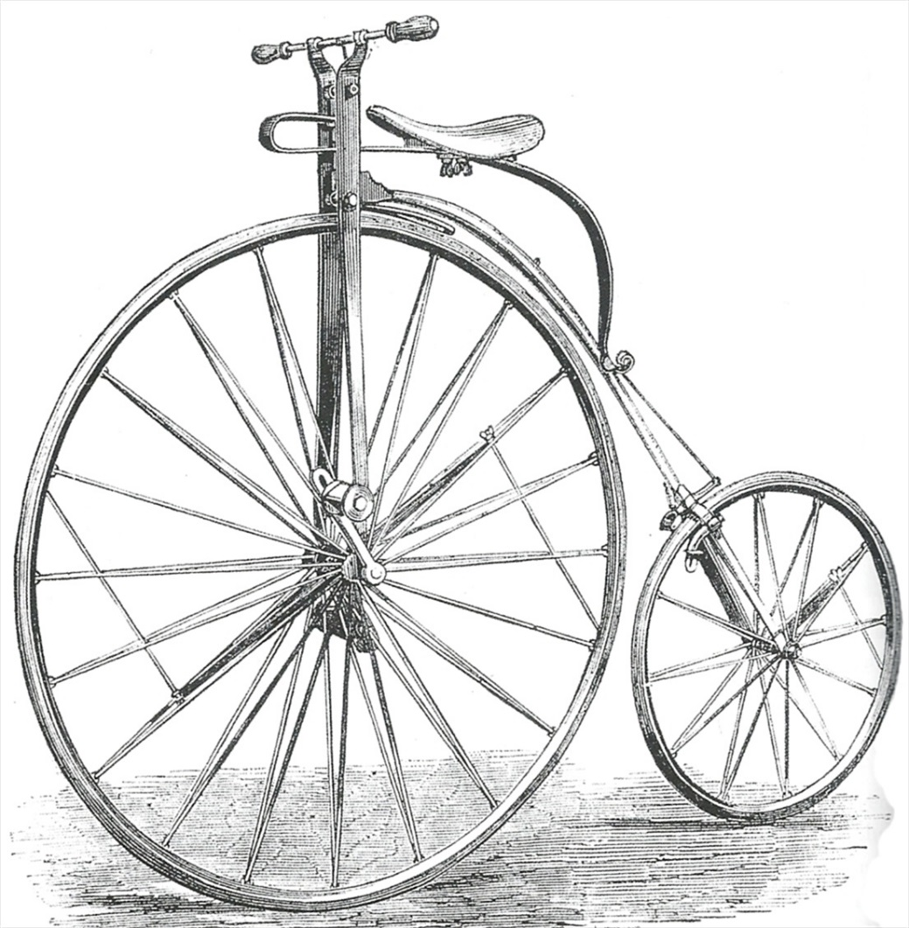
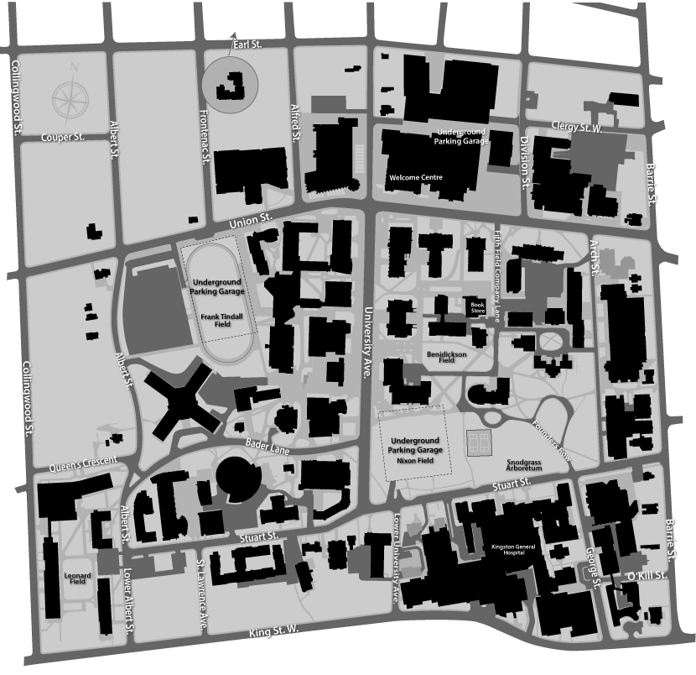
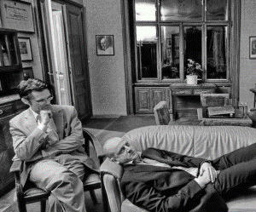
Role of Residence Counsellors
Residence Outreach Counsellors – managed by residence life
Counsellors are embedded across campus
We’re counsellors, too!
Things to consider…
Notes:
We are both mental health counsellors, so we work with the gamut of issues that most other counsellors on campus work with – the one difference being that our offices are within the residences themselves, and our services are marketed specifically toward students living in residence.
This is not necessarily a unique role; however, each campus that has similar positions (know that Wilfred Laurier, Carleton, and Western all have similar) manages it in a slightly different way.
Wheel/spokes – Queen’s embedded counsellors much like spokes off a wheel – any student can speak with counselling in the central counselling services area, and then there are also counsellors available for certain populations as well (ex. Engineering, grad students, etc.). Nadia and I, however, are actually our own little wheel – we were hired specifically by residence life, not by counselling services. We are therefore managed in our day-to-day activities by the director of residence life, but still very much have a connection to counselling services, and all clinical supervision is provided by the director and senior counsellor at counselling services.
Important things to consider in relationship:
Location
Booking appointments
Confidentiality within the residence system – ex. work/meet extensively with Residence Life team
Contact and supervision with other counsellors/mental health professionals on campus
How expertise is used – interactions with other departments for training purposes, etc.

Slide 3
Let’s look at a student…
Sleep
Focus/Concentration
Heart Rate
Friends
Learning Strategies
Worry
Consuming Thoughts
International Centre
Residence Don
Notes:
To give you an idea of how this works on our campus from the student perspective, let’s say we have a student:
Robin, first year student in Arts.
Living in Victoria Hall
Let’s pick one of the more common issues that students present with – Robin is dealing with difficulties sleeping, can’t focus or concentrate on academics, heart racing whenever thinks about doing work, and is really worried about failing, which constantly consumes her thinking.
Connects with:
Learning Strategies – referral to ROC
Friends – go to don
Don – referral to ROC
International student – QUIC – referral to HCDS/ROC
In the meantime, Don writes a PHL/log – this goes to the RLC, who notes that this may be a mental health issue. Sends log to ROC. At this point don’t contact directly, but do respond to the don. If there were red flags, the RLC probably would call directly, or in some cases the ROC would be picking up on something and would reach out to the student directly. Rare, but also rare that help is turned down.

Slide 4
Then what?
Booking appointments
Short-term
Wondering about anxiety
Referral to Health Services
Referral to community supports
Notes:
On our campus, Robin can book via e-mail, phone, or if they are in the same building, walk in and talk/book right then.
Because of the sheer volume of students we work with (cross-campus), we do not focus on long-term counselling. However, students can always connect with us, and especially urgent situations are always seen. Currently it is rare that we are involved in after-hours care, because _________________________, but for example we always have two appointment spots available on Monday mornings, for anything that happened over the weekend – RLCs can book students in to those.
In any case, Robin comes in and we have a fantastic chat about life, the universe, and everything.
Robin is concerned about possibly having anxiety – it is in the family, so has heard the term before.
Again, connections are important – able to refer to health services for a possible diagnosis.
Build some great rapport; however, Robin notes that it’s March and what about next year, when not in residence – have a off-campus resource booklet full of different referrals – help the student to get set up with support that will work best for Robin.

Slide 5
Don’t forget…
Counselling support
Resource support
What about the student staff?
Notes:
Let’s get back to the don, though –
Tracy the don is more front-line staff than probably anybody on campus; Tracy lives, eats, and sometimes even poops in the same room as students living in residence.
Dons, also known at other campuses as RAs, Floor Fellows, or Community Coordinators, are able to use our support in two ways –
As counselling support – both Nadia and I have a number of dons who we have seen for a wide variety of mental health issues
As a resource – dons themselves are supports, but this doesn’t mean they have all of the answers. We will often have dons come chat about the best way to tackle an issue a student is having, setting boundaries, and generally wanting to become more connected on campus.

Slide 6
Additional support
Training
Team aspect
Notes:
As such, we are heavily involved in the training of our student life staff (not just in residence but across campus) on a variety of topics. We’ve found over the past few years that the more involved and visible we are to the frontline student staff, the more confident they feel in connecting students to us when needed.
Should also mention that we not only train professional residence life staff on a number of topics, but are involved in residence life team meetings every week. Part of the meeting is general catch-up for events and things going on in residence, but a large part of our involvement in those meetings is to discuss any students of concern that have come up, and help to give ideas around how specific cases may be managed.
Which is a perfect segue way into…

Slide 7
Thank You!

