Slide 1
Boundaries and Confidentiality
Nadia Sawaya Fehr
Freeman Woolnough
Residence Outreach Counsellors
Queen’s University

Slide 2
What’s on the Agenda …
What are boundaries?
How to set them
The Peer Mentor/Mentee relationship
Confidentiality
Practice

Slide 3
What Exactly are Boundaries?
What do you think?
“Something that indicates the farthest limit”
“Something that was invented to keep people away when you’re sad, mad, or just want to be alone “ (from Urban Dictionary)
“Psychological term for a person's ability to tell themself apart from those around them”
“Anything that helps to differentiate between you and somebody else, or showing where you begin and end”

Slide 4
Why is This Important?
Boundaries help to:
Avoid burnout
Maintain balance
Ensure relationships are mutually respectful and supportive

Slide 5
Setting ‘em

Slide 6
Boundary Domains
Physical
Verbal
Time
Emotional
Relational

Slide 7
Activity
Reflection (Boundary Preparation Handout)
Exercise — in pairs

Slide 8
Types of Boundaries

Slide 9
But …
How will you know when your boundaries are crossed?
Controllers – People who continually try to cross your boundaries
Aggressive
Manipulative

Slide 10
Mentor/Mentee Boundaries
Actions
Words
Thoughts
Physical
Emotional
Behavioural

Slide 11
Peer Mentor/Mentee Relationship

Slide 12
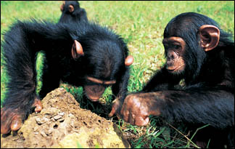
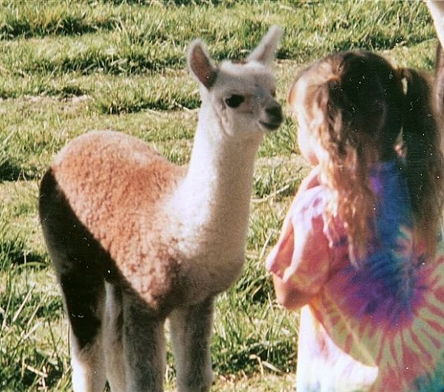
What’s My Role?
So many things!
Approachability
Visibility
Availability
Unique Relationship — Power

Slide 13
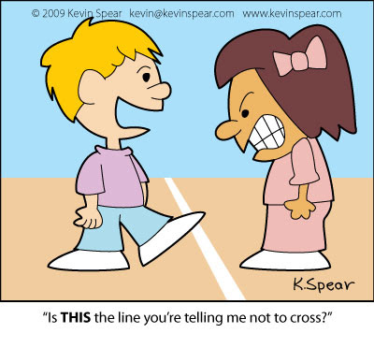
When crossing boundaries is not okay …
Limits of self-disclosure (Who are you sharing this with?)
Physical contact/appearance
Socializing/romance
Social media
Location
Gifts and spending
Reflection

Slide 14
Boundaries — How to set ‘em
Actions
Words
Thoughts

Slide 15
Let’s Practice
Quick practice for the first conversation with your Mentee …
How to talk about and set boundaries
In pairs

Slide 16
Let’s Practice What you can say:
Framing it: “There are a few things we need to go over so you know what this relationship will look like”
“We will be meeting on campus only”
“We need to meet one time per week. It’s important to know that because of all my commitments, I will only be able to offer this much time”
“If you feel you need more than one meeting we can discuss other supports on campus”
“You can contact me through email” (no social media)

Slide 17
Mentees have boundaries, too!

Slide 18
Tact and Confidentiality
Tact
Environment
Timely
No rumours
Approachable
Be prepared
Know your boundaries
Confidentiality

Slide 19
Limits of Confidentiality
Protection
Identifying information
Up, not out
Harm to self
Harm to others
Children under 16
Sexual abuse (health professional)

Slide 20
Let’s Practice 2
Quick practice for the first conversation with your Mentee …
How to talk about confidentiality and limits
Also add in boundaries if possible

Slide 21
Let’s Practice What you can say …
“Confidentiality is important”
“At times I may need to connect with my supervisor so I can provide you the best support possible. I also submit mentoring meeting logs to help my supervisor manage the program. Information will only ever go up, not out.”
“Overall what you say here stays here; the only reason I would need to disclose information outside the program is if:
You were going to harm yourself
Threatening to harm someone else
Harm a child/or had harmed a child
If you knew of someone who was sexually assaulted by a health professional

Slide 22
It’s not always that easy

Slide 23
Recap/Debrief

Slide 24
Questions?

Slide 25
Thanks!

