Slide 1
Breaking New Ground: Integrating Evaluation into Practice
Debbie Chiodo, PhD
Centre for Addiction and Mental Health (CAMH)
Western University

Slide 2
Goal for the Day
Our Hope:
You will leave with the evaluation knowledge, tools & skills to create a culture of learning and evaluation mindset at your organization.

Slide 3
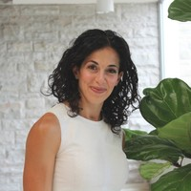
My Professional Journey

Slide 4
Agenda
Understanding what program evaluation is, and what it is not
Principles of evaluation as they relate to understanding how to evaluate your services
Types and stages of evaluation
Developing good evaluation questions for service and practice
Using evaluation tools and templates

Slide 5
“Our very processes of taking in information distorts reality — all the evidence of social science indicates this. We have selective perception — some of us have rose-coloured glasses, some of us are gloom-and-doomers. We are not neutral; there is an emotional content to information. We need disciplined techniques to be able to stand back from that day-to-day world and really be able to see what is going on. We need approaches to help us stand back from our tendency to have biases, prejudices, and preconceptions.”
-Michael Patton
Notes:
Many development programs are evaluated to determine how effective and useful they are. But how effective and useful are the evaluations themselves?

Slide 6

The “science to service” gap is shrinking, but still exists…
Adapted with permission M. Duda, 2013
Evidence-based practice

Slide 7
Why Is EBP Important in Counseling and Psychological Services?
Clinicians have a professional obligation to their discipline to engage in ongoing evaluation of their counseling techniques and approaches.
Clinicians also have a humanistic/ethical obligation (to their clients) in ongoing evaluation of their own practice to determine its effectiveness.
Clinicians also have a responsibility to society to ensure that counseling is a valuable and worthwhile activity.

Slide 8
Why Is EBP Important in Counseling and Psychological Services?
Are the techniques and procedures we are using justifiable in terms of their impacts on our clients well being?
Are the services we are providing the most cost-effective, and least intrusive way to have a positive impact?

Slide 9
What is Program Evaluation?
1

Slide 10
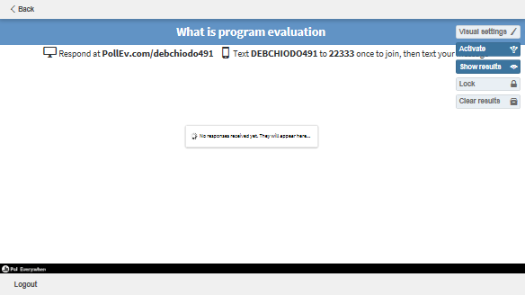

Slide 11
Program Evaluation is ….
Systematic
Objective
Assessment of a program/policy/project
Learning or decision making
How things are actually working
Improvement
Knowledge for specific use
Stakeholder and funder driven purpose

Slide 12
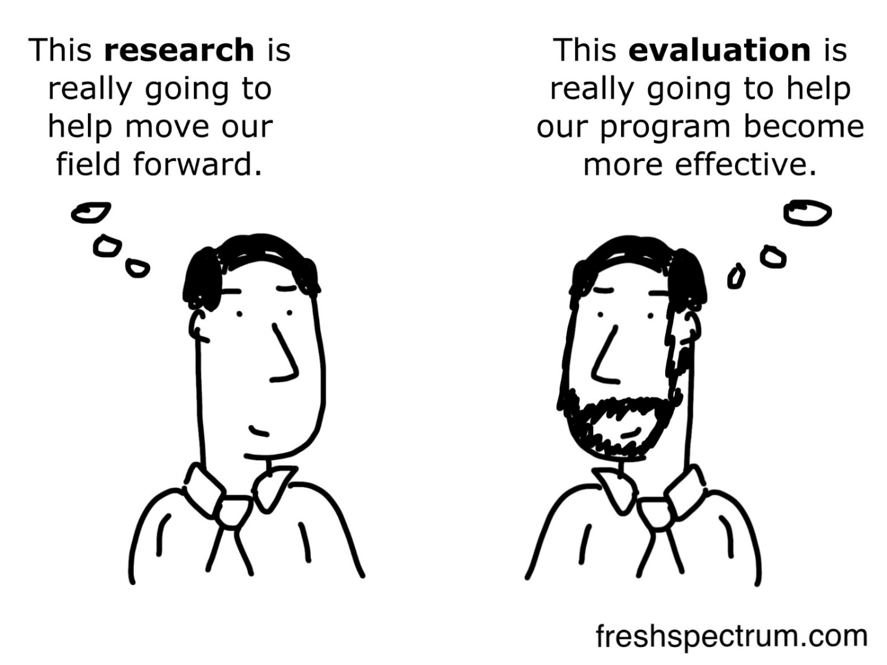
n
What Program Evaluation is Not?

Slide 13
Why Should We Prioritize Program Evaluation?
Push or pull factors
Resource allocation decisions
Increased confidence that we are doing the right things
Collective reflection
Accountability

Slide 14
So, how are we doing with program evaluation?

Slide 15
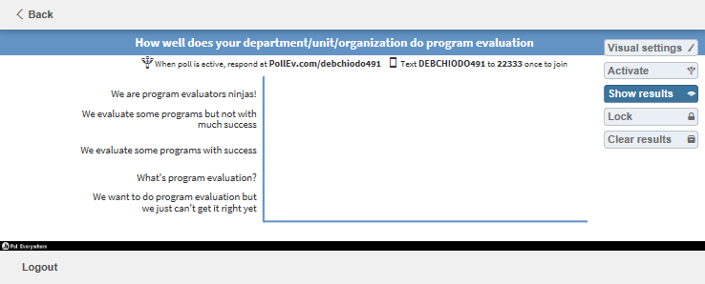
How are we doing with program evaluation?
Notes:
-

Slide 16
Evaluation challenges for clinical & applied settings
Competing agendas
Clinically, there is a fear that our performance/skills will be judged
Confusing terminology
What else?

Slide 17
Some Principles of Evaluation… Especially as they Apply to Practice
Program evaluation should be part of the planning and change process.
Know why you are conducting evaluations.
  See Handout: Evaluation Worksheet Handout #1

Slide 18
Some Principles of Evaluation… Especially as they Apply to Practice
Don't take the "value" out of evaluation.
Build measurement into all processes.
Every measure of performance has its shortcomings.
You can't measure everything all the time.
Evaluation doesn't change systems, feedback and reward do.

Slide 19

Let’s take stock…what does this mean for you?

Slide 20
First we do, then we find out how well it worked

Slide 21
Types and Stages of Evaluation
Beginning (Formative)
  Time of intervention planning, how will you determine the success of intervention
  Developing program/intervention
  Formative and developmental
  Improvements and PDSA (See Handout #2)
Somewhere in the Middle
  Implementation
  Process
End (Summative)
  Outcome, effectiveness, experience, long-term change

Slide 22
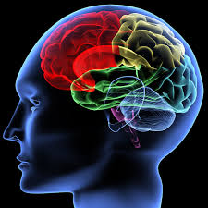
Let’s Take a Brain Break or a Syn-Nap
The brain needs time to process!
  Stretch
  Walk and talk
  Move around
  Get up

Slide 23
If I had to explain program evaluation to my nine year old ….
At the end of the day, most if not ALL PROGRAM evaluation seeks to answer some variation of these questions:
Are we making a difference?
What ingredients of our work are crucial to this difference?
How do we know?

Slide 24
Part of the success of program evaluation starts with good evaluation questions
General guidelines
  Clear, specific, and well-defined
  “Do boys or girls have more talent related to technology and does education play a role?”

Slide 25
Part of the success of program evaluation starts with good evaluation questions
  Need to be measurable by the evaluation
  Feasible
    “How can poverty among immigrants be reduced”?
  You must first define the purpose of your evaluation and scope (remember handout #1)

Slide 26
Part of the success of program evaluation starts with good evaluation questions
They are different if you are doing a process-focused evaluation versus an outcome-focused evaluation

Slide 27
Process Evaluation
Process questions focus on….
  Who?
  What?
  When?
  Where?
  Why?
  How?
Describe
Discover
Seek
Explore
Report
Q1. How is the program being implemented?
Q2. Who is attending the program?
Q3. How do students describe their experiences in the program?

Slide 28
Outcome Evaluation
Outcome questions focus on:
  Changes?
  Effects?
  Impacts?
  Assumption that it will answer some theory or assumption being tested
  Did {program} have a {change/effect} on {outcomes} for {individuals}
  Q1. Did students change their attitudes/knowledge/behavior after program completion?
  Q2. Did the program produce changes in students’ wellbeing/academic performance?
  Q3. Are the services we are providing improving students’ mental health?

Slide 30
Satisfaction IS NOT Outcome Evaluation

Slide 31
What evaluation questions are you thinking about…?
Notes:
White board or flip chart

Slide 32
Basic steps to complete an evaluation
Evaluation Planning
Indicators and Tools
Data Collection
Learning
PDSA

Slide 33
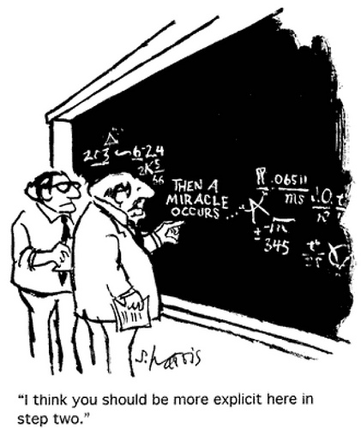

Slide 34
Most of us want to think of program evaluation as
If….Then Statements
Notes:
But

Slide 35
The Challenge: We make BIG Claims
IF…
Then
We run a mindfulness program….
Students academic performance will improve
We implement a new intake process….
Our waitlists will disappear

Slide 36
What is one solution? Create a Logic Model
(See Handout # 3)

Slide 37

Road map picture
Notes:
Many different models available
There is no one way
I will talk about a logic model as it refers to a program but it can be a theory, an action, an intervention, a policy …
Anything that you invest in, do something about, and want to see what results are achieved.

Slide 38
Logic Model Basics
A picture of your program
Clarifies the strategy underlying your program
Builds common understanding
Communicates what your program is and is not about
Forms a basis for evaluation
Notes:
A picture of your program: what you are putting into the program, what you are doing, and what you are trying to achieve
Can be a graphic, table, flow chart, narrative
Clarifies the strategy underlying your program – theory of change;
Builds common understanding, especially about the relationship between actions and results
I don’t think Logic Models have exactly the warmest reception to people outside of the evaluation world, and I think its because people like myself and other evaluators who take our work very seriously will show up at a community meeting, the evaluation is third on the agenda and we hand out our draft logic model in paper size to the group around the table, in 11X 18 scaffold, and it looks a little something like this

Slide 39
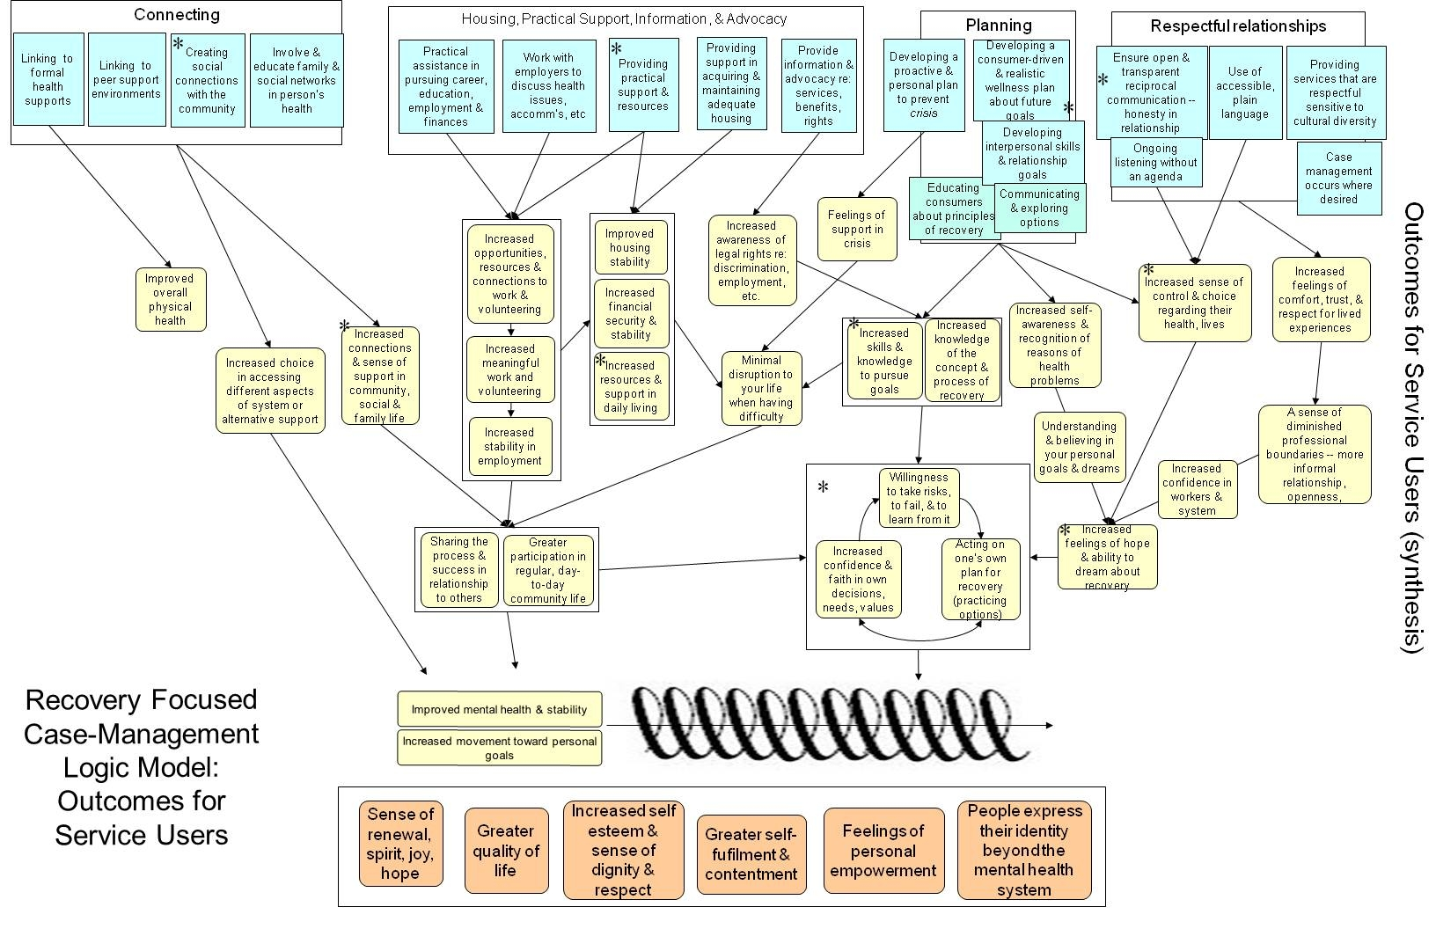
Notes:
And with the greatest intentions, and the greatest enthusiasm, complicated logic models have a place in your project but you have to be very strategic as to where and when they come out… Simple is better and that doesn’t undermine the value of the research evaluation, what it does ensure in my experience, is that it actually becomes a document people want to use because when something looks like this, no one wants to use it … and it will be a check mark of a deliverable for the project that is made

Slide 40

Every Day Example
Inputs
$300
Activities
Go to store
Hockey Store
Outputs
ST Outcome
Fitting in
Happier
Better shot
Greater
attachment
LT Outcome
Healthier kid
Notes:
Bauer Nexus 1N GripTac Composite Stick
Inputs – resources he is requesting …
My first question was WOW – what are you going to do –that is an awful lot of money to ask…
I need to go to mall and do shoppping
Hey .. I need a Bauer nexus
Activities: what you do with that resources
Output –what you produce with those activities
ST- change resulting from activities
LT- change from the ST activity
Ok what are we going to get out of this – that is your output
So why do you need this – all my friends are getting one, I want to be the best hockey player and this stick will help me, I am going to feel more part of my team, increase acceptance
Me as the funder is saying - no way I am not paying for that
What happens if we step back and
So why do we absolutely need to consider developing a logic model for evaluation?

Slide 41
Using Your Logic Model for Program Evaluation
Evaluation is the process of asking—and answering—questions:
  What did you do?
  How well did you do it?
  What did you achieve?

Slide 42
So, why bother? What’s in this for you?
Some common comments . . .
    “This seems like a lot of work.”
    “Where in the world would I get all the information to put in a logic model?
    “I’m a right brain type of person – this isn’t for me.”
    “Even if we created one, what would we do with it?”

Slide 43
The Value of the Logic Model Process
Engages stakeholders.
Clarifies program theory and fills in the gaps.
Builds ownership of the program.
Builds common understanding about the program, especially about the relationship between actions and results.

Slide 44
The Logic Model
Program Goal: overall aim or intended impact
Resources/Inputs
The inputs dedicated to or consumed by the program
Activities
The actions that the program takes to achieve desired outcomes
Outputs
The measurable products of a program’s activities
Outcomes
The benefits to clients, communities, systems, or organizations
How?
Why? So what?

Slide 45
Example: FN Peer Mentoring Program Logic Model
Program Goal: Break the cycle of poverty for Indigenous youth by using culturally-relevant programming that promotes learning, leadership, coping skills, and resilience
Resources
Funding
Community partners
Youth
Program facilitators
Mentoring program
Space
Evaluator
Activities
Relationship building with community partners
Recruit students for program
Deliver mentoring program
Monitor and track student data
Work with community partners to enhance programming
Outputs
# of youth in mentoring program
# of academic credits
# of days absent from school
# of youth engaging in cultural practices/activities
Outcomes
SHORT:
increases in the availability of culturally relevant programming in schools
--youth satisfaction with participation in mentoring program/ academic course
-community partner satisfaction
MEDIUM:
-improvements in school attendance
LONG:
-homelessness prevented

Slide 46
The Logic Model: A Series of “If-Then” Statements
Resources
Activities
Outputs
Outcomes
Certain resources are needed to run your program
IF you have access to them, THEN you can accomplish your activities
IF you can accomplish these activities THEN you will have delivered the services you planned
IF you have delivered the services as planned THEN there will be benefits for clients, communities, systems or organizations

Slide 47
Resources/inputs: What do you need to implement this program?
Human resources
Facilities
Equipment/supplies
Partners
Technology
Grant money

Slide 48
Activities: What is the program doing?
Think broadly first:
  Outreach
  Training
  Consultation
  Staff Development
  Partnership Development

Slide 49
Activities: Then think about details
Outreach
Develop and distribute flyers
Meet with community agencies
Training
Recruit training team
Recruit participants
Provide training sessions

Slide 50
Outputs: What is the program producing?
# of workshops held
% of students served
# of students attending each workshop
# of community partnerships formed

Slide 51
Outcomes: What difference is the program making?
Outcomes are about change:
  New knowledge
  Increased skills
  Changed attitudes or values
  Modified behavior/practice
  Changed conditions

Slide 52
Outcomes are what you expect TO CHANGE but …indicators are what you measure
Indicators are the specific, measurable characteristics or changes that represent achievement of an outcome.
Indicators are measurable and observable and answer the question: How will I know it?

Slide 53
What is a reasonable level of ambition for an outcome?
Consider your timeframe
Consider the scope of your resources and activities
Consider what other factors might influence the achievement of outcomes
Be ambitious but don’t set yourself up!!

Slide 54
Benefits of Logic Model
Provides a common language
Helps us differentiate between “what we do” and “results” --- outcomes
Increases understanding about program
Guides and helps focus work
Leads to improved planning and management
Increases intentionality and purpose

Slide 55
Other evaluation tools and templates
Evaluation framework (See Handout #4)
Evaluation strategic plan

Slide 56

Wrap Up – What’s your SMIT?
Share the Single Most Important Thing (SMIT) that you took away from today’s session and will apply to your current work…
Notes:
Andrea

Slide 57
Questions and Comments?
Contact: dchiodo@uwo.ca

