Slide 1
Campus Peer Support for mental health and substance use health

Slide 2
What are you hoping to walk away with today?
Welcome!
https://jamboard.google.com/d/1_aw5uVeOGsj3gelwVByMT3R05ynJLnZIMn45Gf17Rx8/edit?usp=sharing
Notes:
Use this slide to highlight some information, or share list items

Slide 3
Poll #1
Notes:
Use this slide to highlight a subsection

Slide 4
“Peer Supporters are like friends with mental health training, we do not give them advice or treat them like clinicians do, we listen to them like a friend and understand what they are going through because Peer Supporters have experienced similar things firsthand. Peer Supporters are survivors of mental illness and/or addiction, we are able to understand when perhaps no one else in their life does. Peer Support is intended to eliminate the power imbalance between helper and helpee. Speaking to a Peer supporter is similar to speaking with a friend who supports you and builds you up instead of making you feel small.”
James Martin UNB Peer Supporter
Notes:
Quotation Slide

Slide 5
MUTUALITY
Maintain mutually agreed upon limits and
boundaries in the peer support relationship.
TRUST
Are collaborative in building equal, open and trusting relationships with peers.
DIGNITY
Respect external limits and boundaries within the context of their role as a peer supporter.
HEALTH, WELL-BEING AND RECOVERY
Practice self-care, monitor their own wellbeing and are aware of their own needs, as well as promote self-care for their peers.
How do
Peer Support VALUES
relate to
Peer Support PRINCIPALS?
SELF DETERMINATION
Recognize that the goals, values and beliefs of their peers may not be the same as their own.
SOCIAL INCLUSION
Share their lived experiences in a manner that demonstrates compassionate understanding and inspires hope for recovery.
PERSONAL INTEGRITY
Recognize the importance of an individual approach to recovery.
LIFE-LONG LEARNING
Aspire to be current within their field of
practice by remaining up-to-date regarding
available resources, especially those that are locally available, and by engaging in continuous learning.

Slide 6
Project Overview
Part 1

Slide 7
Partnership Team
UPEI
CMHA PEI
UBC
Medicine Hat College
CMHA Alberta Southeast Region
Trent University
CMHA HKPR
UNB
CMHA NB
Notes:
Use this slide to highlight a subsection

Slide 8
Project Design
PHASE 1
September 2021 to August 2022
Key deliverables: Design and develop training curriculum and certification processes. Selection and training of trainers for pilot sites.
PHASE 2
September 2022 to August 2023
Key deliverables: Pilot training and certification of peer supporters across 5 post-secondary sites.
Gather insight from national stakeholders/collaborators
1
2
Scaling and replication through our CMHA federation.
Beyond 2024
LOOKING TO THE FUTURE
Key deliverables: Developmental evaluation and knowledge translation.
September 2023 to March 2024
PHASE 3
3

Slide 9
By the end of this training program, you will be able to:
Explain your role and responsibilities as a peer supporter
Build connection with peers
Prioritize your own well-being while supporting others
Demonstrate effective communication strategies
Support peers who may be struggling with additional resources as required
Learning Outcomes

Slide 10
Modules
01 Peer Support Overview
04 Communication Skills
Principles of peer support
Role & responsibilities of peer support
Listening to understand
Questioning techniques
Sharing of experiences
Using inclusive language
Training Content
02 Connection & Belonging
Personal experiences & biases
Trust building
Welcoming spaces
05 Additional Support
Crisis situations
Local resources
Principles of self-determination
03 Self-care Strategies
Wellbeing tips
Resilience strategies
Substance use health

Slide 11
Supports for Peers
For building their foundation
For navigating their unique peer role
For success in their campus job
Session handouts & resources
Self-directed activities
Communities of Practice
Ongoing touchpoints with CMHA Peer Support Experts
Community peer support service offerings
Campus supervisors and staff for direct support in day-to-day responsibilities
Integration and connection with Campus services

Slide 12
Poll #2
Notes:
Use this slide to highlight a subsection

Slide 13
Pilot Site Panel
Part 2

Slide 14
Poll #3
Notes:
Use this slide to highlight a subsection

Slide 15
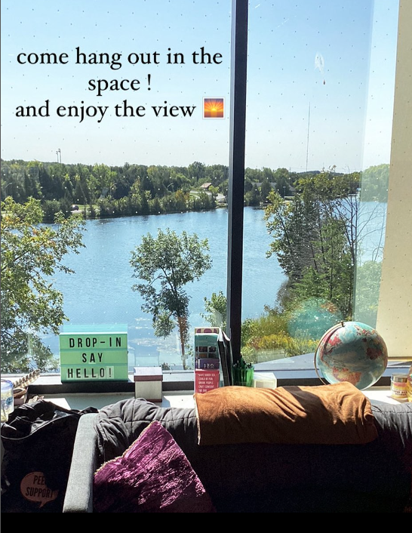
“I love Peer Support but the one-on-one time is the most beautiful for me. I learn so much about myself and how I want to care for other students on campus. Its such a good opportunity not just for the students who come to talk, but for me as well. ” Trent Peer Supporter
Notes:
Quotation Slide with picture

Slide 16
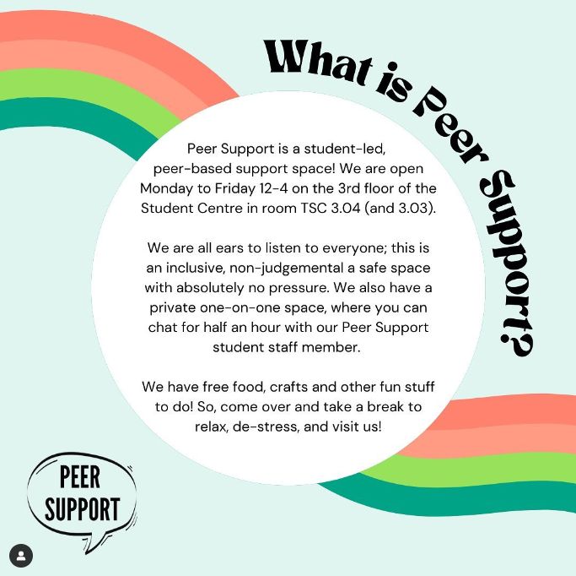
“My favorite thing has to be about getting to know more about people and their experiences or what they have to talk about when they come in the space and share. It sometimes feels nice to know that we are all in the boat together and not alone; there will be problems but there’s always solutions and support which is so great! Totally PEER support!!” Trent Peer Supporter
Notes:
Quotation Slide with picture

Slide 17
Caitlin Jacobs | cjacobs@trentu.ca
Joaquin Santana | jsantana@cmhahkpr.ca
Christine Crough | ccrough@cmhahkpr.ca
Matthew MacLean | macleanm@unb.ca
Lauren White | Lauren.White@cmhanb.ca
Corey Ferguson | Corey.Ferguson@cmhanb.ca
Bonnie Lipton Bos | bliptonbos@cmha.ca
Contact Us

